Slide 1



Do Uber/Lyft Reduce Parking Violations in New York City?
Team Members:
Junjie Cai
Junru Lu
Pranay Anchan
Shijia Gu
Yuxuan Wang
Mentor:
Prof. Zhan Guo

Slide 2
Contents
1 Motivation
2 Problem Definition
3 Relevant Studies
4 Data Description
5 Methodology
6 Results
7 Conclusions

Slide 3
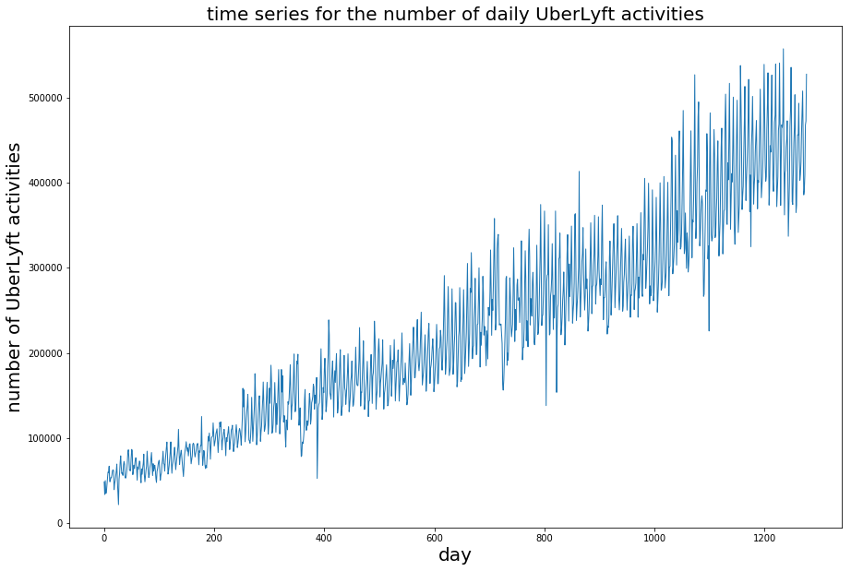



Motivation
Distribution of number of Uber & Lyft Trips in NYC per Day
Number of Trips
Day (2015-2018)

Slide 4




Motivation
Uber and Lyft are suspected to hurt the public transit system
Uber and Lyft are increasing congestion in major cities
Uber and Lyft are reducing people from biking and walking

Slide 5


Problem Definition
Assist in understanding impact from Uber and Lyft
Provide policy insight to Uber / Lyft regulation and Parking Enforcement
Casual Effect
Parking Violation

Slide 6

Relevant Studies
Study 1: Impacts of Ridesourcing
Used a self-collected dataset to study why people use ridesharing services
These services can potentially help in
reducing parking demand
Due to the size of the dataset (416 rows), the analysis is not very conclusive
Study 2: Parking Ticket Trends in NYC
Using clustering analysis and clustergrams, ticket observations can be separated into distinct groups based on the type of violation and the day of issuance
Tickets for illegal stopping/parking, blocking traffic, etc. tend to be in areas with greater commercial concentration of traffic
Usually occurring in areas where parking is scarce.
Notes:
Dataset from surveys of both drivers and passengers - looked at aspects such as
Can be logically inferred from his results that TNC helps in reducing vehicle traffic, parking demand and violations.
Variation of character within NY - mostly residential in SI, largely commercial in Manhattan
Parking and tickets could be correlated
Future work - information about vehicle owners - like location / income etc.

Slide 7
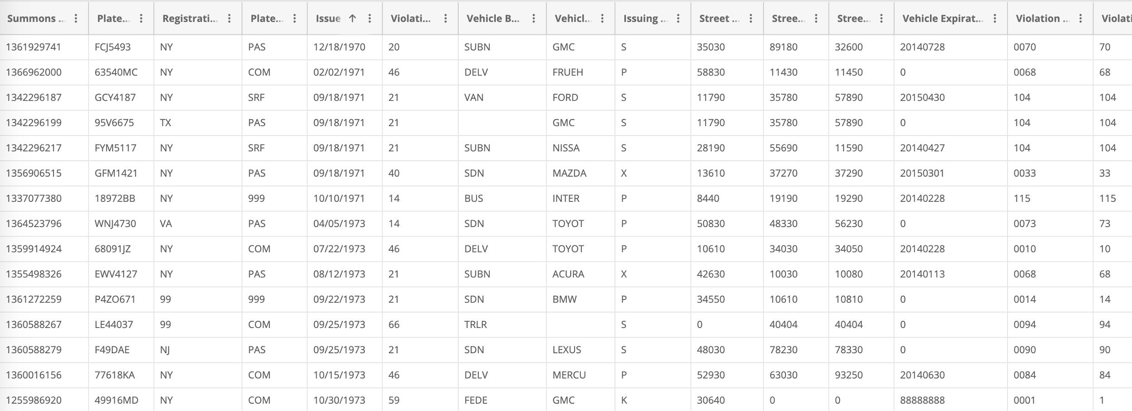
Data Data Description - NYC Parking Ticket Data
NYC Parking Ticket Data from 2015 - 2018
Provided 97 types of parking tickets, but only 80 of them are included
Limitation: no specific geospatial information for each parking; only street name and borough are provided
Geocoded using Google Maps Api to map each parking ticket to an approximate location with Longitude and Latitude
Notes:
80 - related to private vehicles

Slide 8
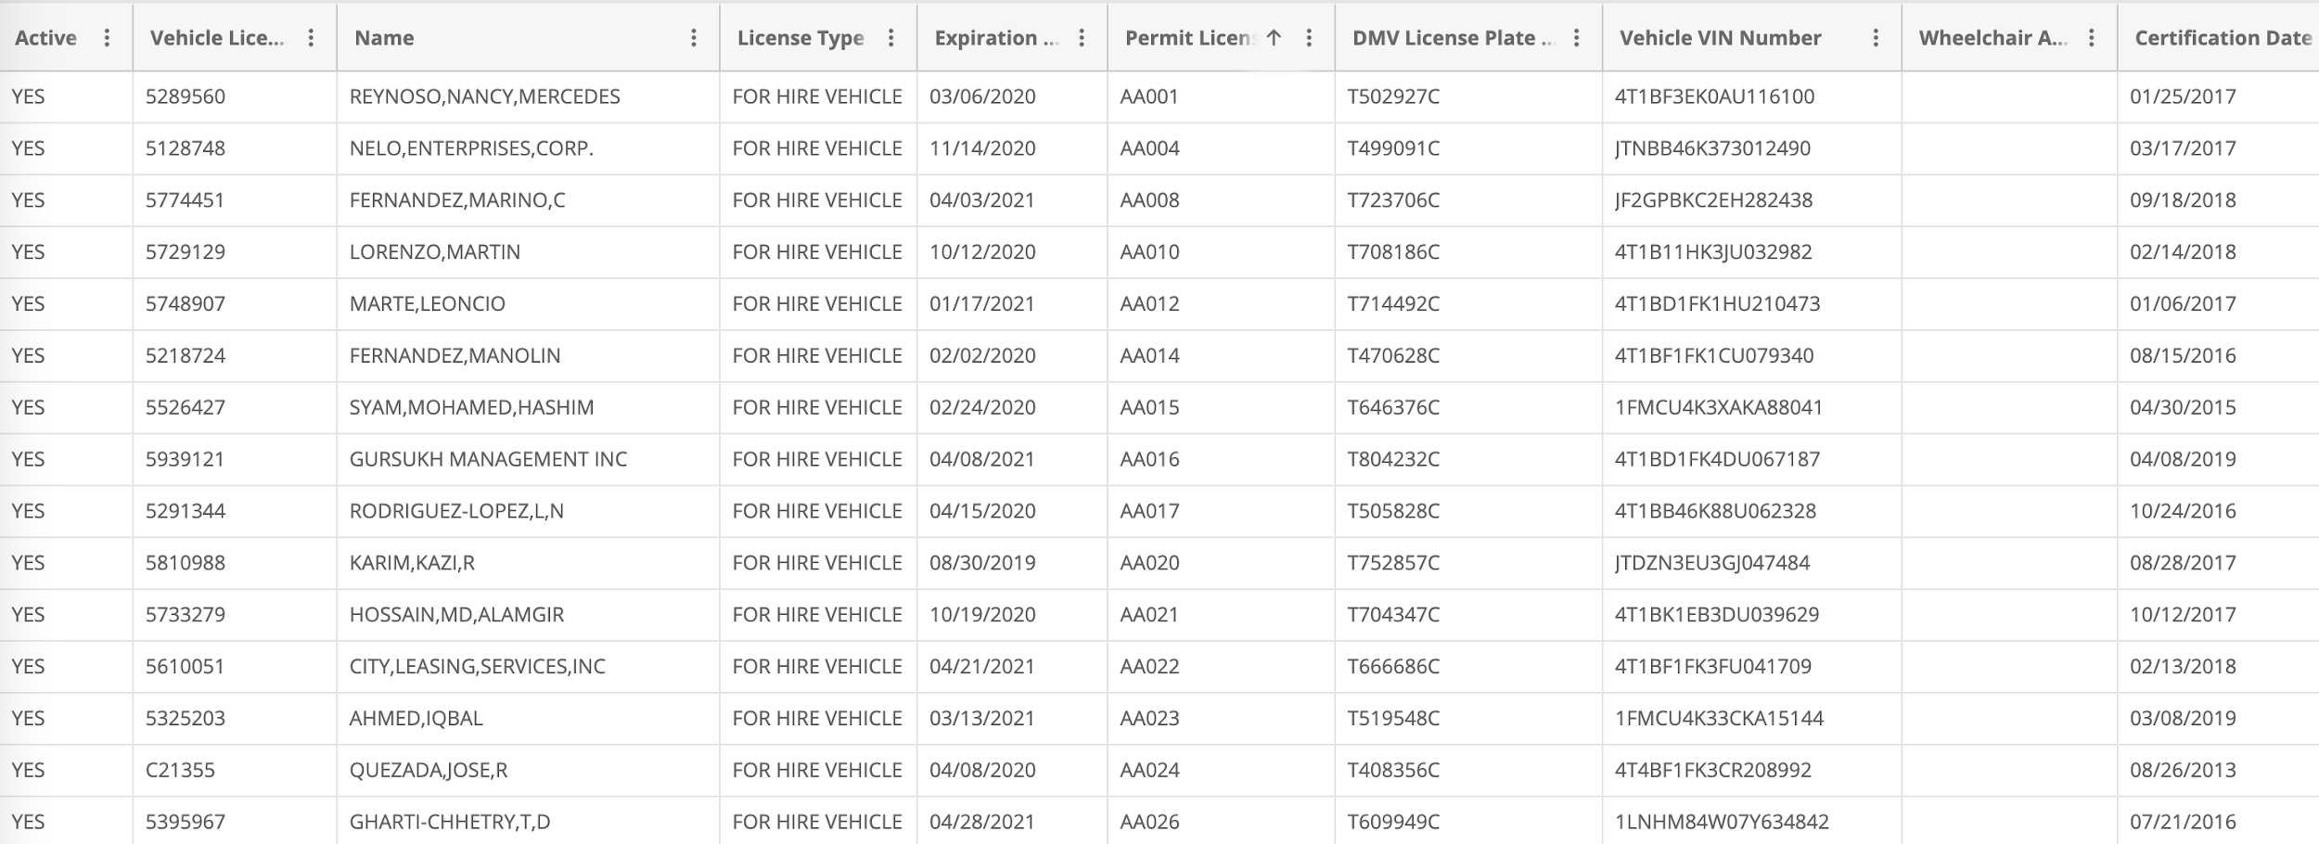
Data Data Description - Uber & Lyft Data
Original data, For-Hire Vehicle dataset, is from Taxi & Limousine Commission website
Included detailed information of each trip conducted by Uber & Lyft
Only included data of trip conducted by Uber and Lyft from 2015 to 2018

Slide 9
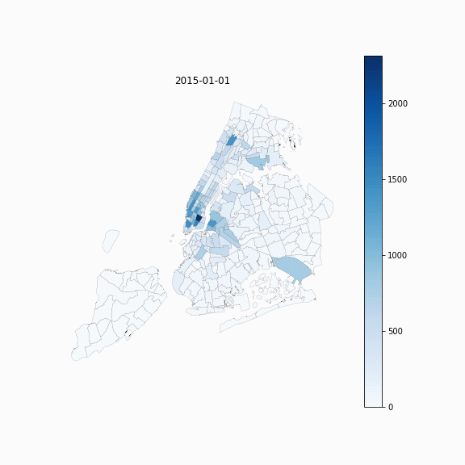

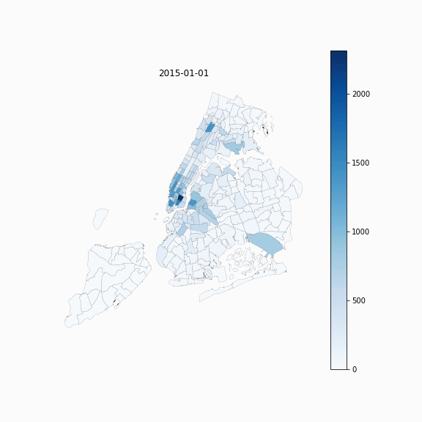
Data Data Visualization
Time series choropleth of Uber & Lyft trips - 2015 to 2018
Yearly
Monthly
Daily

Slide 10
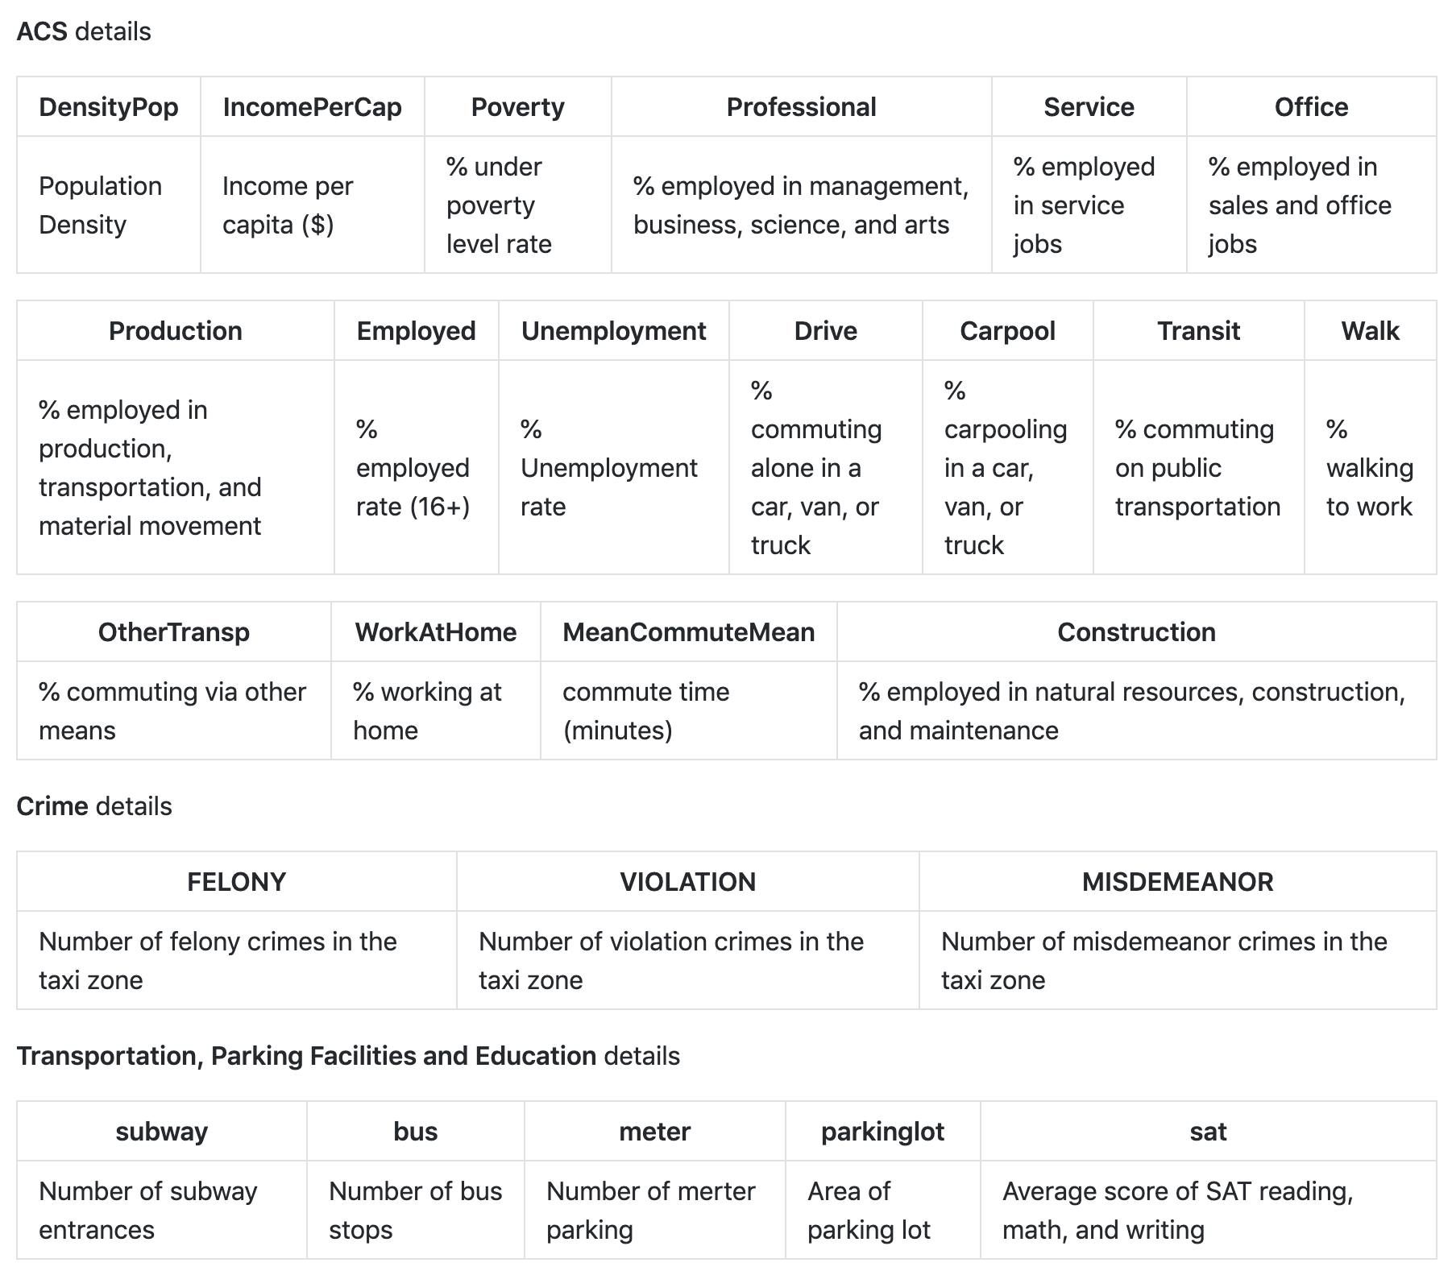
Data Data Description - Additional Data
ACS: from the American Community Survey 2015 5-year estimates
Crime, transportation, Parking Facilities and Education: from NYC Open Data

Slide 11
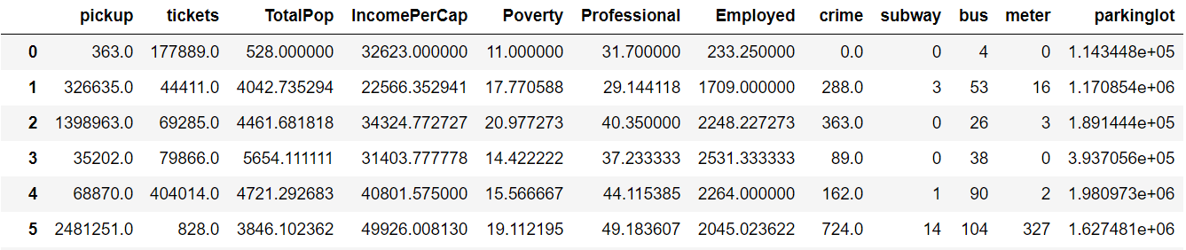
Data Data Description - Prepared Dataset

Slide 12

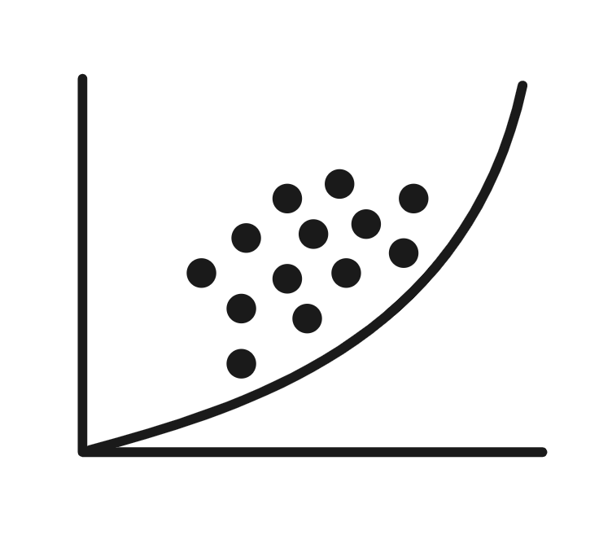


Methodology
Bayesian Network
Fixed Effect
Difference in Differences

Slide 13
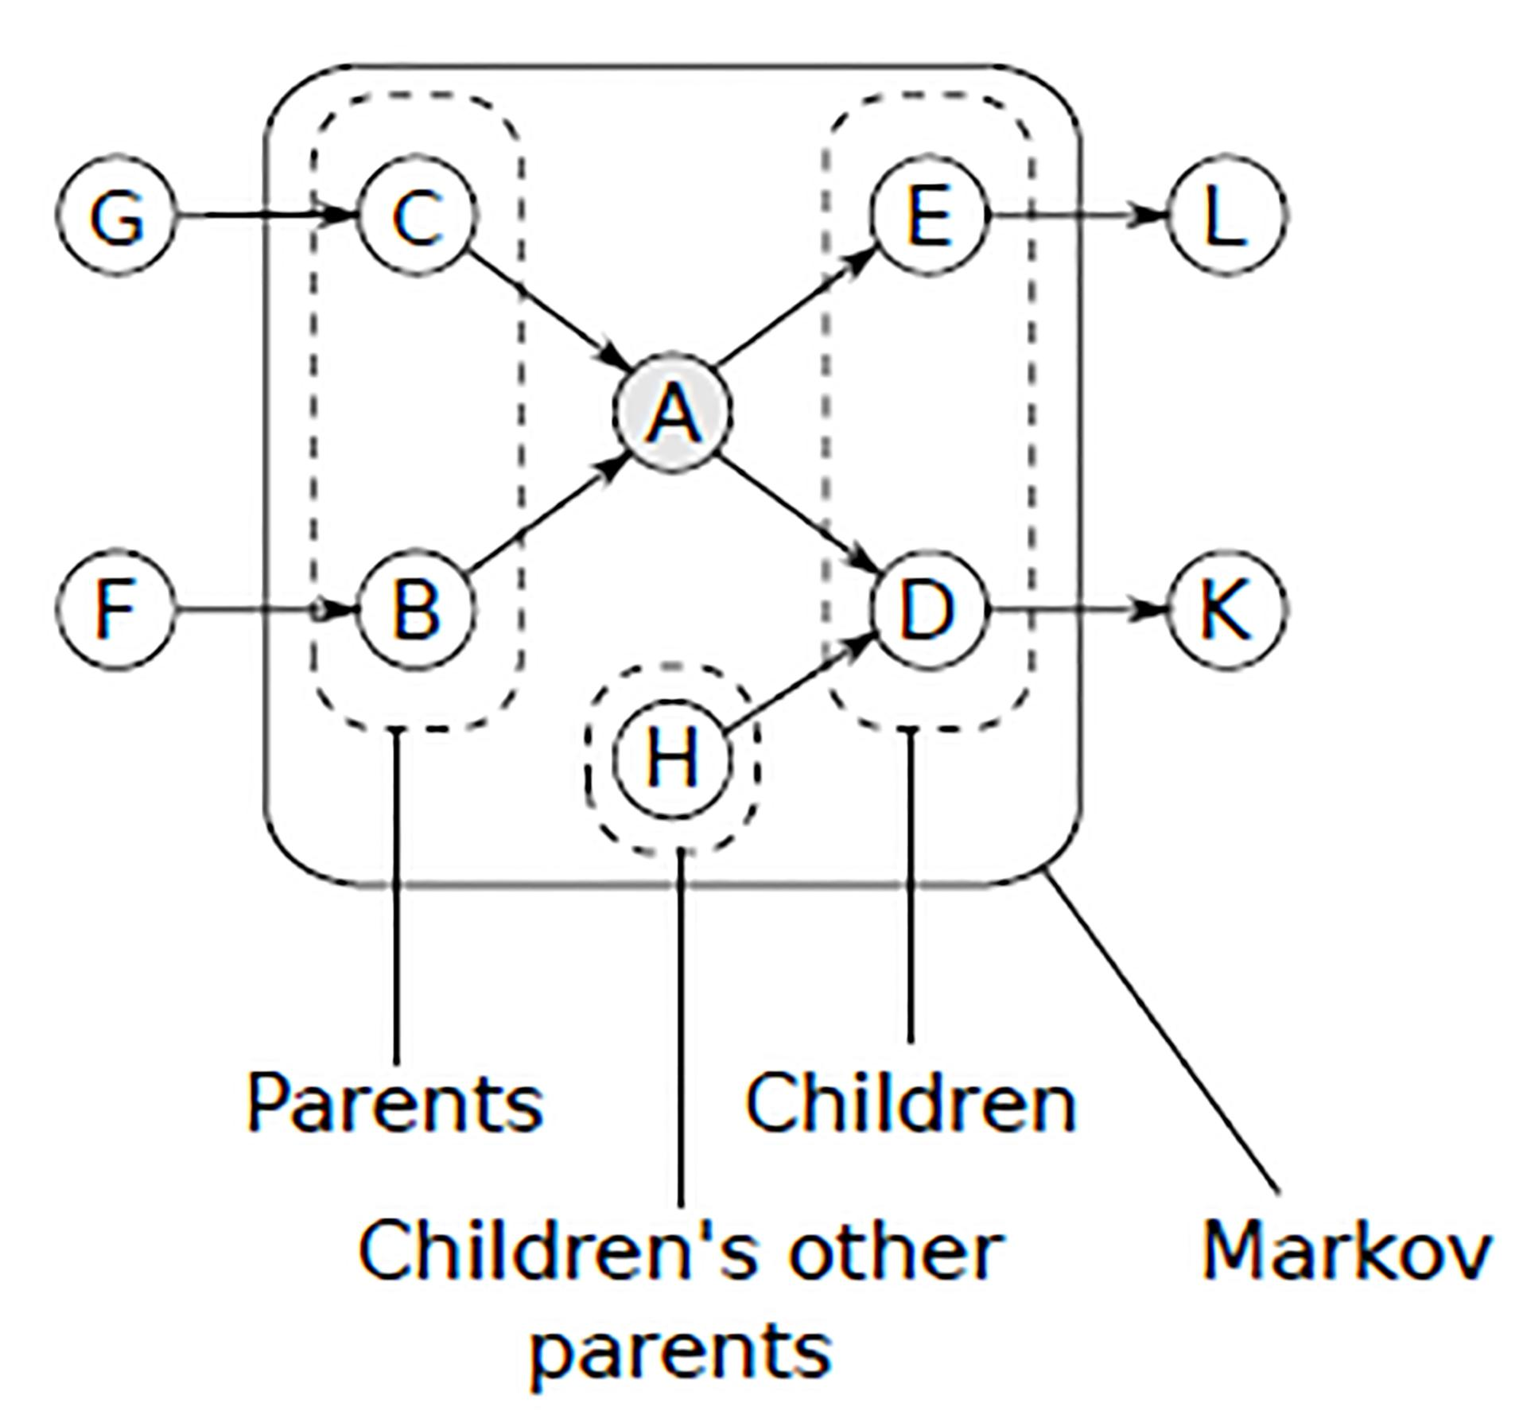
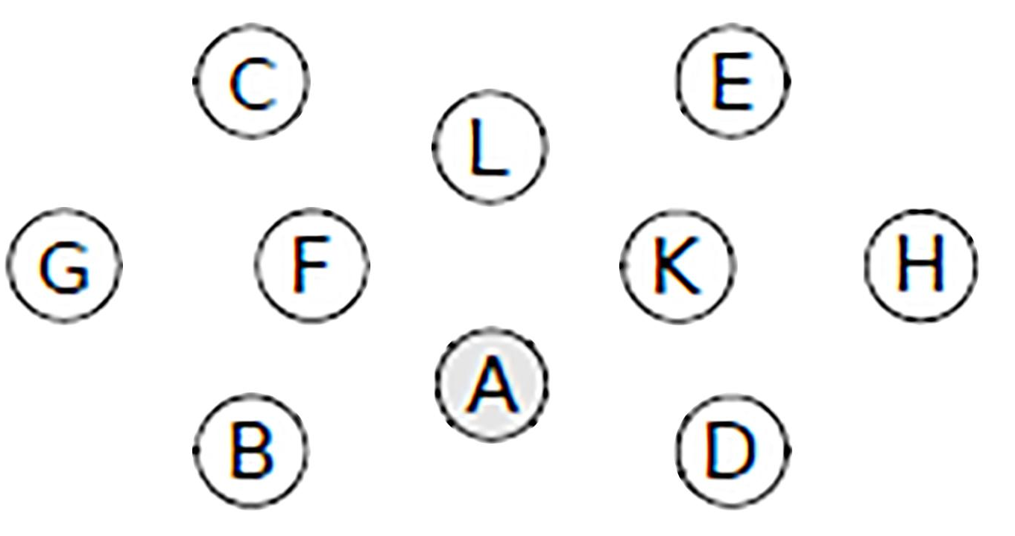
Methodology - Bayesian Network
Data
Parking Violation
Potential Causations:
Uber / Lyft Trip
Average SAT Score
Poverty Rate
... …
12 features included
Algorithm
Result
Bayesian Network
Structure Learning
Score-based learning
Constraint-based learning

Slide 14
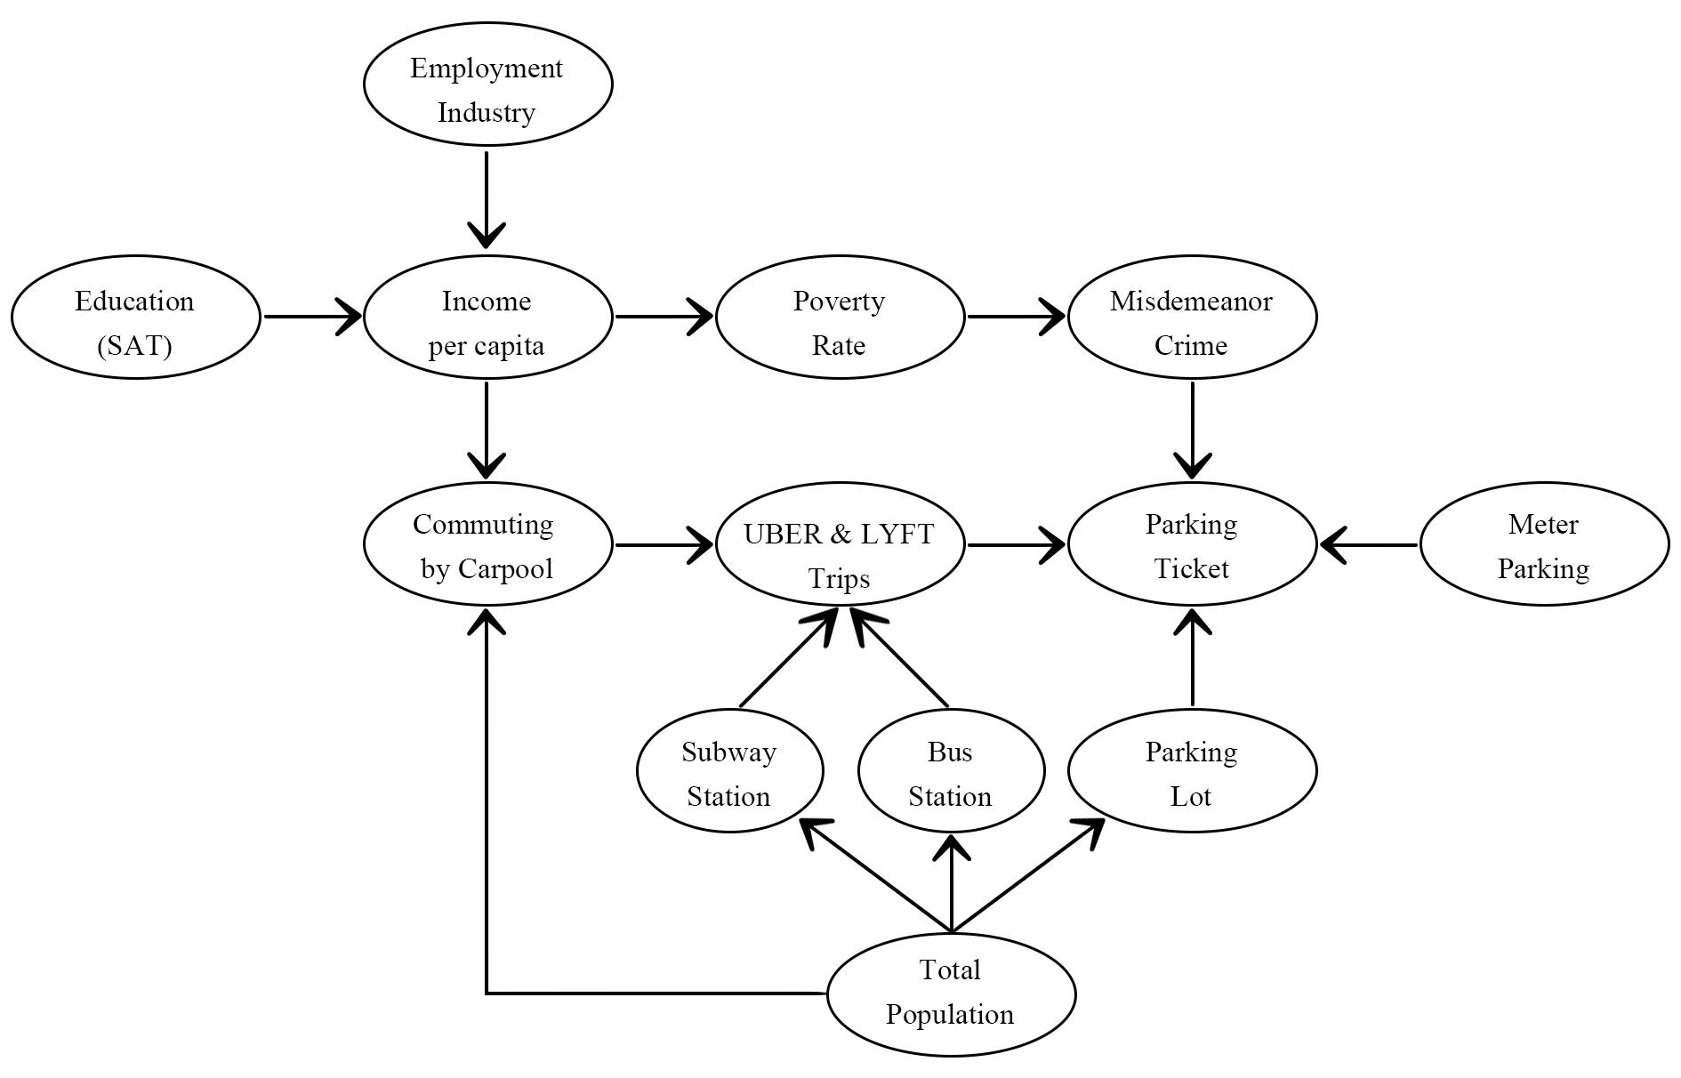
Results - Bayesian Network
Uber & Lyft have direct influence on the parking violation.
Limitation exists:
Parameter learning is missed due to the computation capacity
Impact direction (positive / negative) and strength remains unknown
Without unobserved variables.

Slide 15
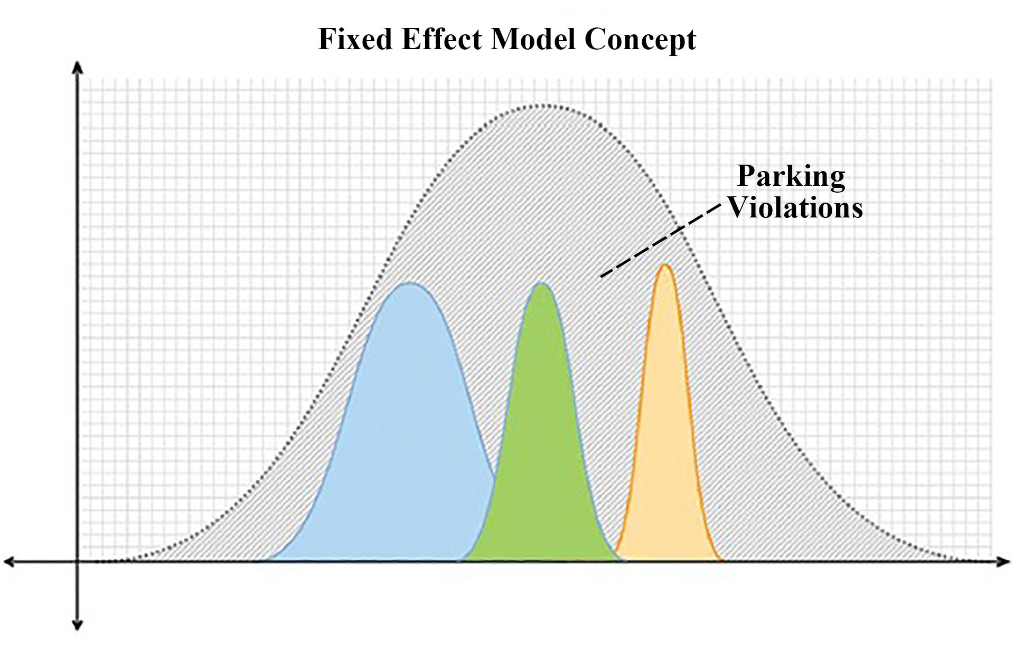
Methodology - Fixed Effect Model
The fixed effects model (FEM) controls for the unobserved factors for causal inference with panel data.
Notes:
Reference:
http://databeauty.com/blog/statistics/2017/09/08/meta-analysis.html
https://hammock.glass/2017/11/26/fixed-effects-vs-random-effects-models/
https://medium.com/@sincos600/%E9%96%B1%E8%AE%80meta-analysis%E7%A0%94%E7%A9%B6-%E4%BB%A5bcog2017stillbirth%E7%82%BA%E4%BE%8B-81d7b3576bb0

Slide 16
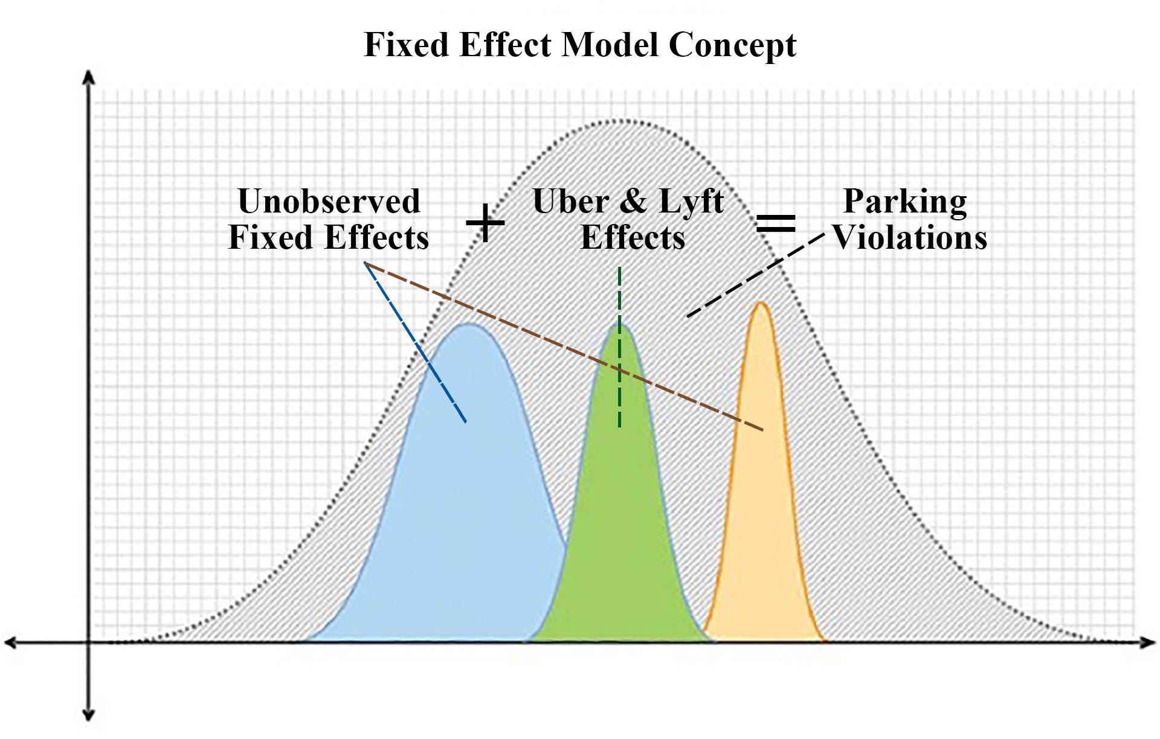
Methodology - Fixed Effect Model
The fixed effects model (FEM) controls for the unobserved factors for causal inference with panel data.
Parking Violations are decomposed into Uber & Lyft Effects and fixed effects.
Dummy variables of each taxi zone were added to a standard OLS model to evaluate the fixed effects of the number of Uber & Lyft trips across different taxi zones.
Notes:
Reference:
http://databeauty.com/blog/statistics/2017/09/08/meta-analysis.html
https://hammock.glass/2017/11/26/fixed-effects-vs-random-effects-models/
https://medium.com/@sincos600/%E9%96%B1%E8%AE%80meta-analysis%E7%A0%94%E7%A9%B6-%E4%BB%A5bcog2017stillbirth%E7%82%BA%E4%BE%8B-81d7b3576bb0

Slide 17
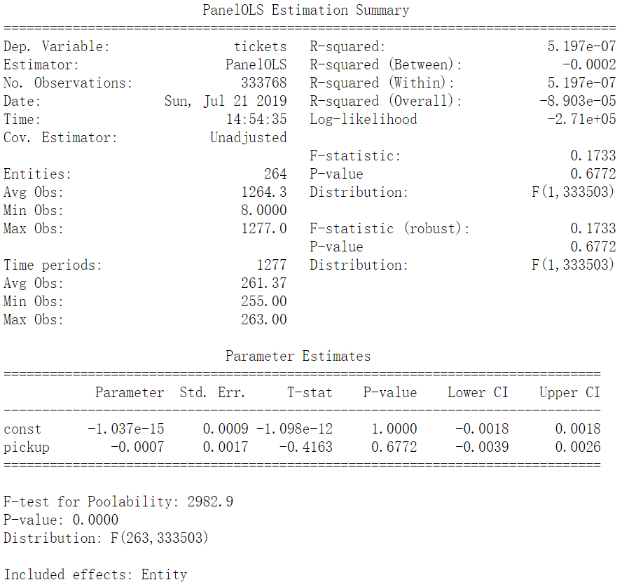
Results - Fixed Effect Model (FEM)
FEM with PanelOLS
Low R-squared:
Number of parking tickets cannot be explained by Uber & Lyft trips solely
Coefficient: -0.0007
Uber & Lyft reduce parking violations in NYC, but the effect is small
P - Value: 0.677
Much Larger than 0.05 (significant level)
The effect is not significant

Slide 18
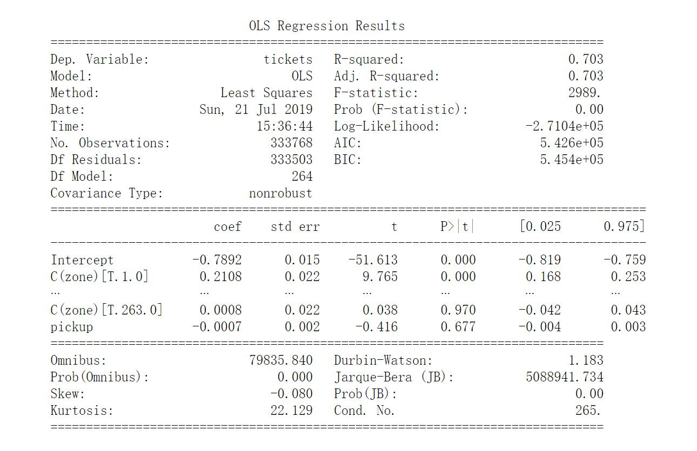
Results - Fixed Effect Model (FEM)
FEM with Dummy Variables
R-squared :0.703 -> More variance explained by dummy variable
Coefficient and P value of number of Uber & Lyft trip remain the same
Coefficient: -0.0007
Uber & Lyft reduce parking violations in NYC, but the effect is small
P - Value: 0.677
Much Larger than 0.05 (significant level)
The effect is not significant

Slide 19
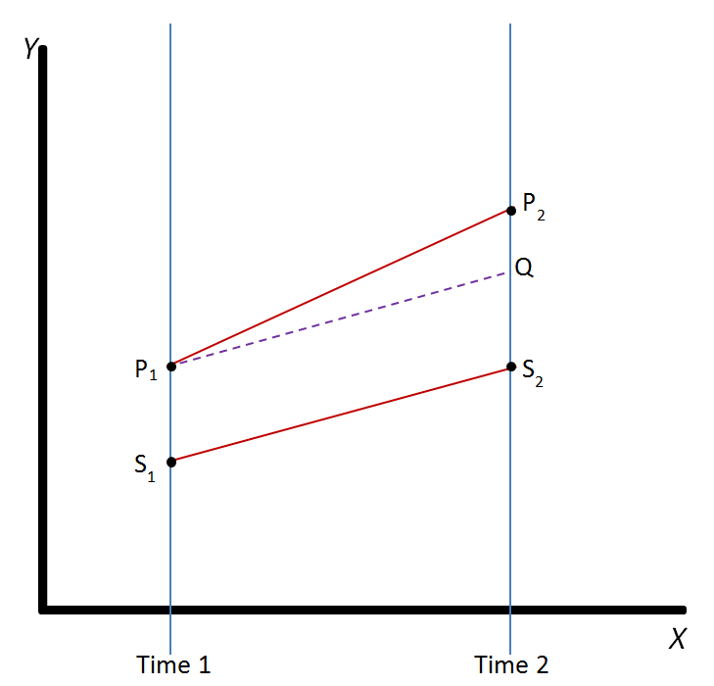
Methodology - Difference in Differences (DID)
Expected difference of Parking Tickets between two groups: Q - S2 = P1 - S1
Actual difference of Parking Tickets between two groups: P2 - S2 = P2 - Q + P1 - S1
Causal Effect of Uber/Lyft Trips on Parking Tickets: CE = P2 - Q = (P2 - S2) - (P1 - S1)
Causal intensity of Uber/Lyft Trips on Parking Tickets: CI = Difference of Uber/Lyft Trips between two groups / ((P2 - S2) - (P1 - S1))
Pi: Parking Tickets for treatment object in period i, i = 1 or 2
Si: Parking Tickets for control object in period i, i = 1 or 2
Q: Expected parking tickets for treatment object in period 2
Notes:
The 3rd model is DID. Within the framework of natural science, two identical New York Cities, one having Uber/Lyft in it and the other not, are needed to strictly prove the causal effect of Uber/Lyft on parking violations. However, these are almost impossible to be found in social science research. Consequently, DID was applied, which aims to find highly homogenous objects P and S to mimic the control and treatment groups. As shown here, the causal effect brought by the difference of treatment is P2 - Q.

Slide 20

Methodology - Difference in Differences (DID)
Pairs of Homogeneous Cab Zones
K-Means Clustering
Number of parking ticket of each Taxi Zone in 2014
2. Socioeconomic, crime,
parking capacity
Information (45 variables in total)
263 Taxi Zones
Over 900 Pairs in Total
Notes:
Cross-clustering was applied to find homogeneous taxi zones. On the one hand, we used the number of parking tickets in 2014, which had not been affected by Uber/Lyft. On the other hand, we clustered with 5 additional datasets just introduced above, which describe the taxi zones from other aspects. We picked over 900 pairs that always belong to the same clusters under both views as homogeneous taxi zones.

Slide 21
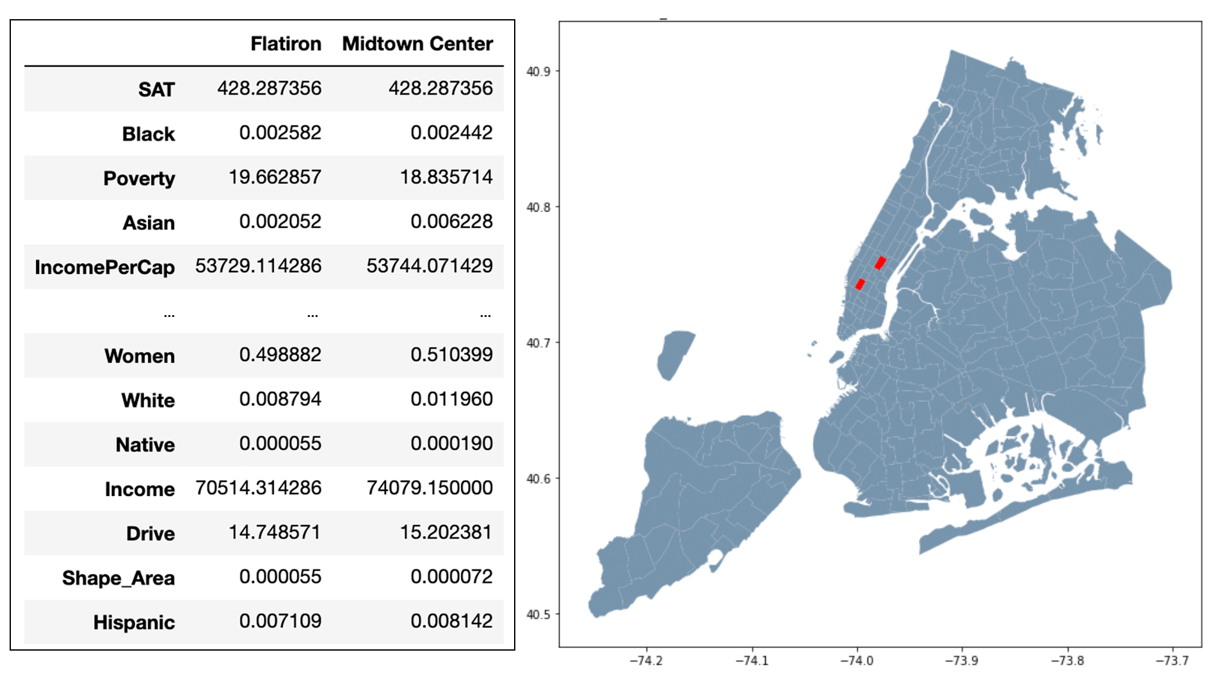
Methodology - Difference in Differences (DID)
Midtown Center Taxi Zone
Flatiron Taxi Zones
Notes:
Let’s see one example: Flatiron and Midtown Center.

Slide 22
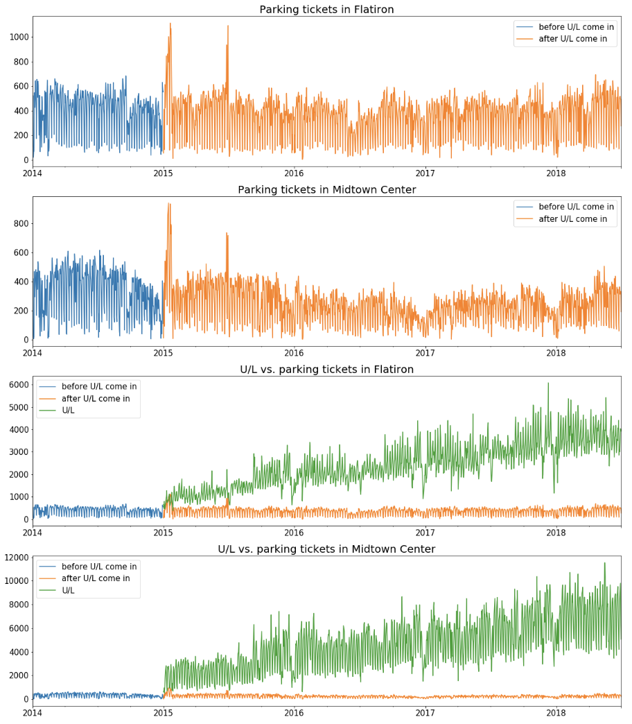
Methodology - Difference in Differences (DID)
Notes:
The blue lines show their similarity in parking tickets in 2014. Also, as you can see from the right table, some major features are very similar. These prove their similarity.

Slide 23
Results - Difference in Differences (DID)
Notes:
More than that, the treatment effects brought by Uber/Lyft, the green lines, are quite different. The trips in Midtown Center are almost twice the trips in Flatiron from 2015 to 2018. So it is perfect to use DID to estimate the causal effect. We got similarity, and we got some differences.

Slide 24


Results - Difference in Differences (DID)
Increase of 224.2 Uber/Lyft trips
Decrease of 1 parking ticket
Notes:
Based on these 900 pairs, we know the average causal intensity is: 1 parking ticket will be decreased with every 224 Uber or Lyft trips increasing.

Slide 25


Conclusions
Potential Impact
An example of using data science to study impacts of Uber/Lyft
Offer Policy Insight:
Uber / Lyft Regulation
Parking Enforcement
Other Related Regulation
Causal Effect
Direction: Negative
Effect Size
Parking Violation

Slide 26
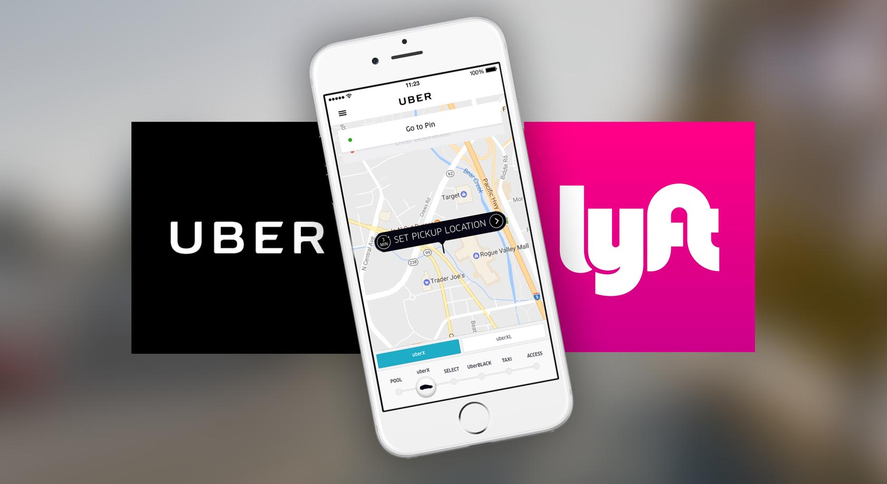
Thank You !

